Slide 1

AGN monitoring - Mrk421 Photometry & Polarimetry -
Astronomical Observation and Lab. 1
Suho · Donghwa · Cédric

Slide 2
▶ Contents
Definition of AGN and Blazars
Information of our target Mrk421
Importance of studying Mrk421
Methodology
Photometry
Polarimetry
Results
Conclusion

Slide 3
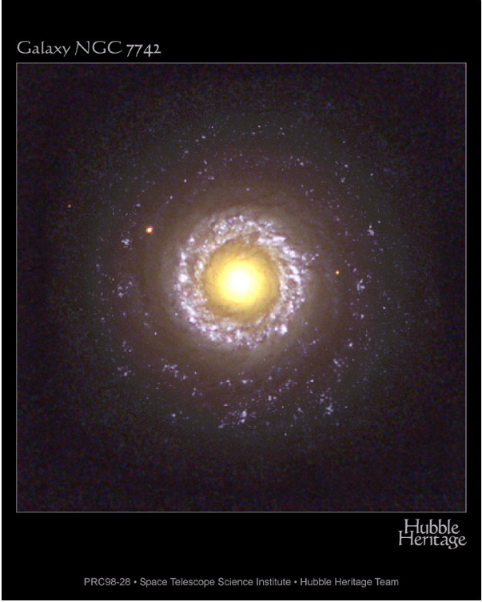
What is an AGN?
- Active Galactic Nucleus
- Compact region at the center of a galaxy with higher luminosity
- Result from the accretion of matter by a SMBH at the center
- Most luminous persistent sources of electromagnetic radiation

Slide 4
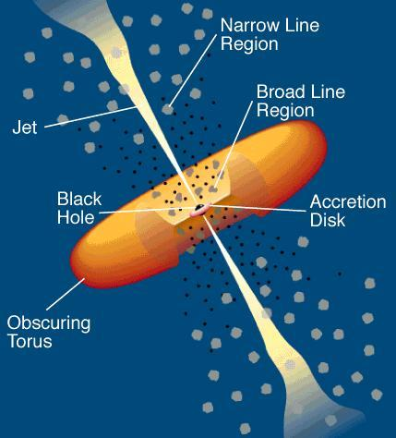
What are Blazars?
- AGNs that have a jet aligned with the observer
- Polarization variability studies may provide information on the structure and magnitude of the magnetic fields

Slide 5
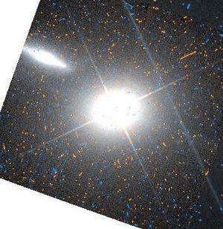
Markarian 421 (Mr k 421)
- A blazar located in the constellation Ursa Major (큰곰자리)
- Strong source of gamma ray
- Magnitude g’=13.804, r’=13.090, i’=12.805
- About 397 million LY apart (z=0.0308)
RA 11h04m27s , Dec +38°12´
Companion Galaxy (Mrk 421-5)
Wikipedia “Markarian 421” https://en.wikipedia.org/wiki/Markarian_421, 2018-06-13

Slide 6
Importance Of Studying Mrk 421
- Provides a phenomenological picture of the physical mechanism driving the observed patterns.
- The spectral curvature is relevant to the understanding of radiative mechanisms.
- One of the closest and most studied blazars.
- Excellent candidate to study physical processes within blazar jets and correlations among different energy bands.

Slide 7

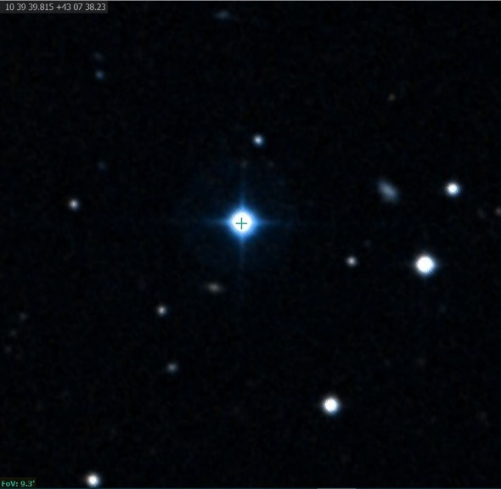
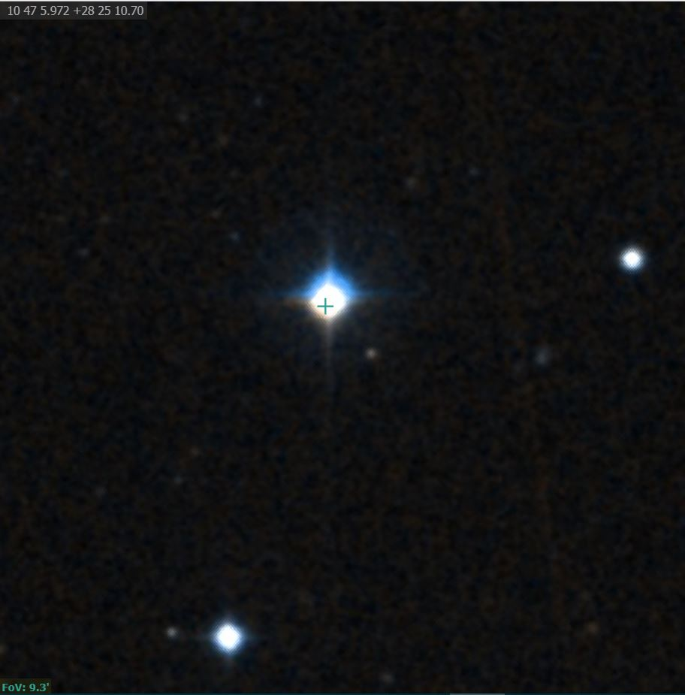
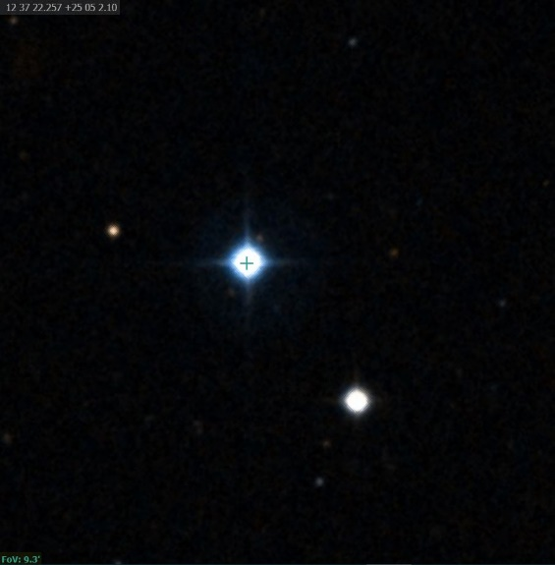
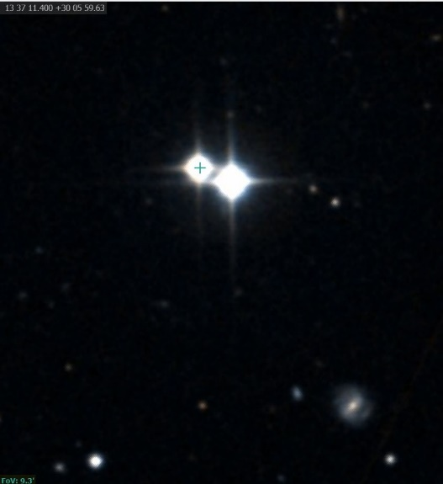
Methodology – 1. Photometry
1) Selection of standard stars
First day (4/17)
Second day (5/8)
Simbad, “HIP52181”,”HIP52771”, “HIP61602”,”HIP66441”, http://simbad.u-strasbg.fr/simbad/, 2018-06-13
Captured image

Slide 8
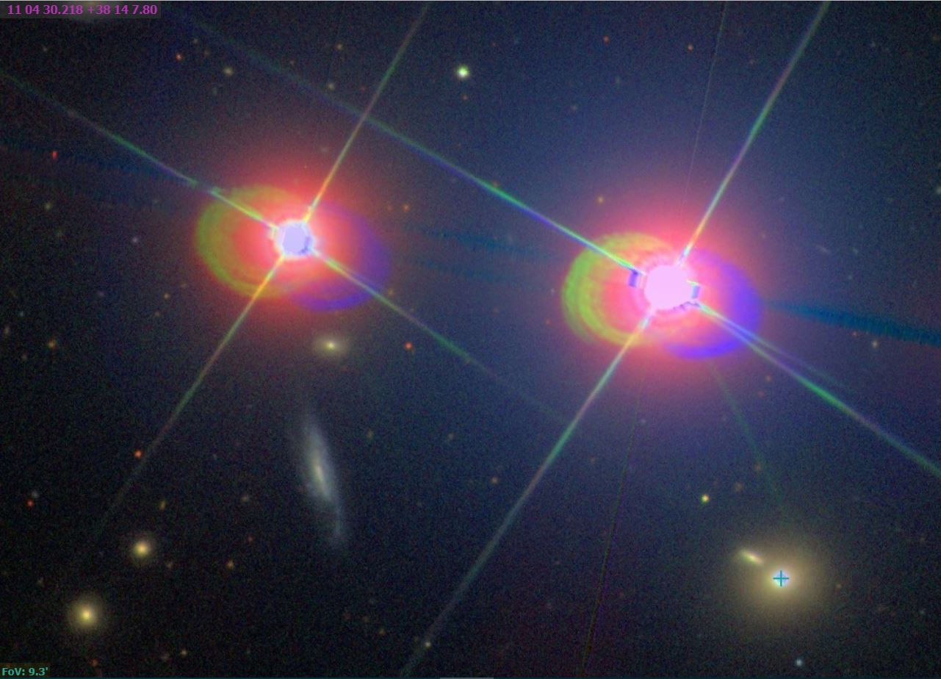
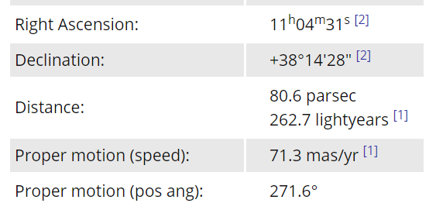
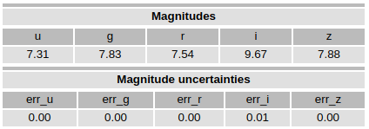
1. Photometry
2) 51 UMA
Simbad, “mrk421”, http://simbad.u-strasbg.fr/simbad/, 2018-06-13
Captured image

Slide 9
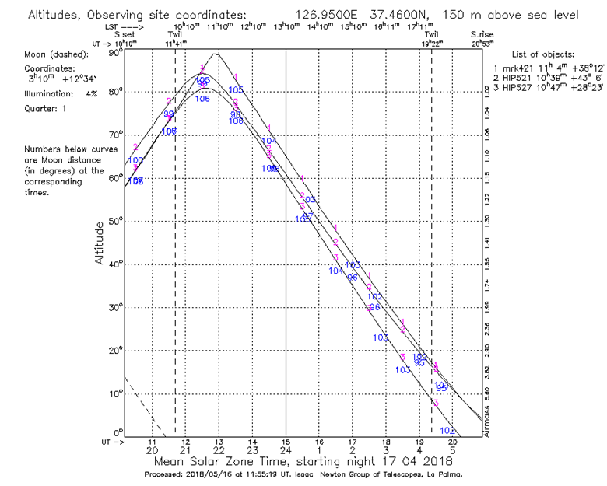
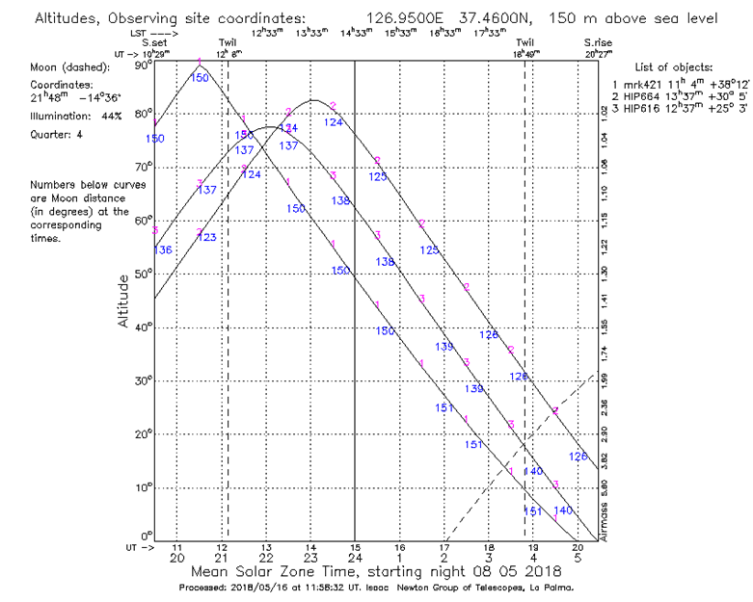
1. Photometry
Observation schedule
Altitude-time graph of first day (4/17)
Altitude-time graph of second day (5/8)

Slide 10
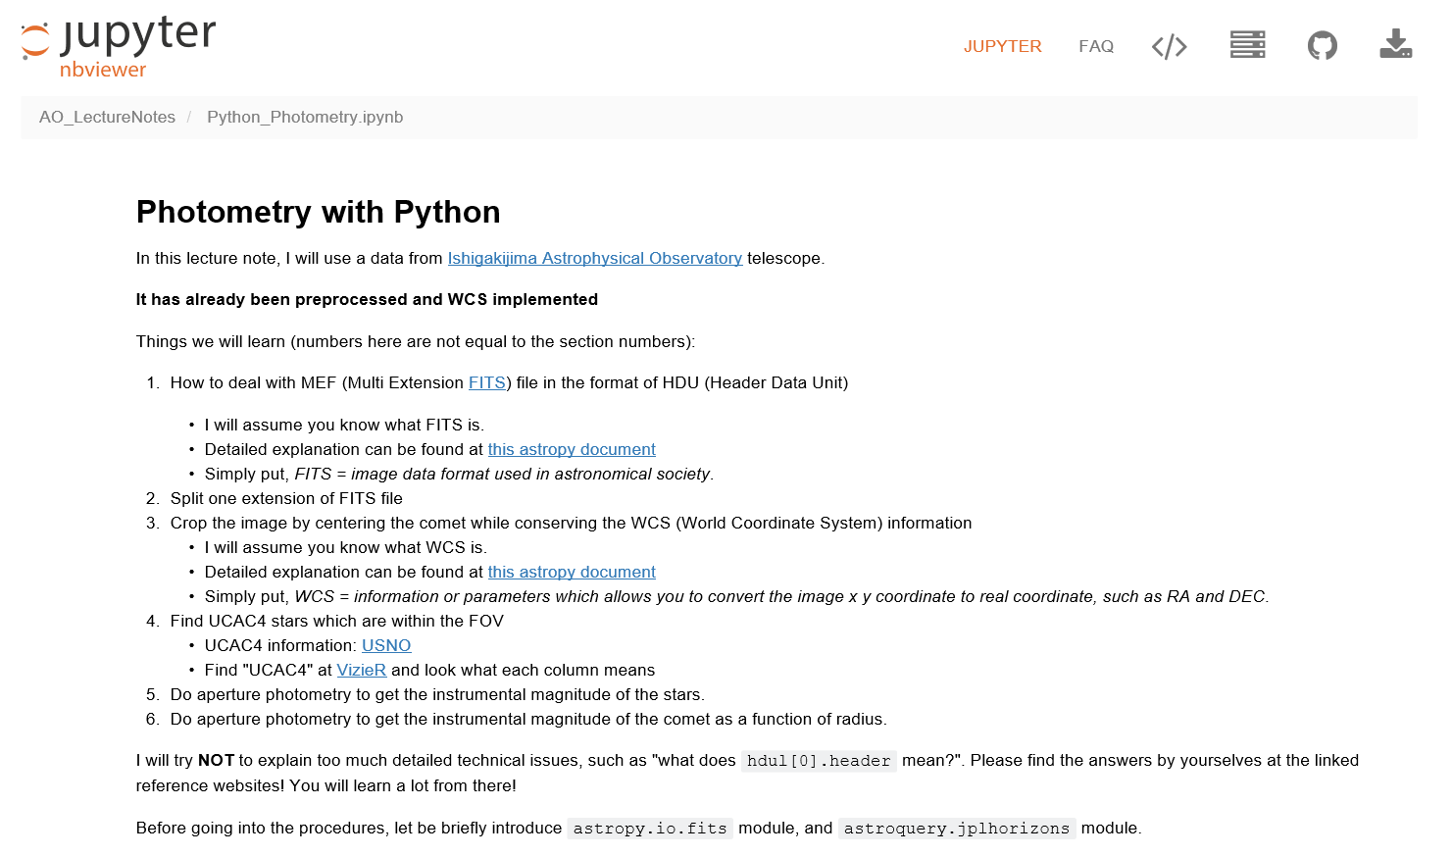

1. Photometry
4) Processing
- TA’s lecture note codes & TRIPOLpy
Suho

Slide 11
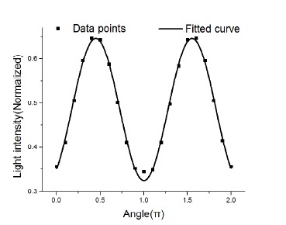
2. Polarimetry
- AGN emission is polarized
- The purpose is to calculate the degree of polarization
ResearchGate, “How can I measure the linear degree of polarization at 90 degrees?”, 2018-16-13, https://www.researchgate.net/post/How_can_I_measure_the_linear_degree_of_polarization_at_90_degrees2

Slide 12

2. Polarimetry
2) What is the degree of polarization (P) ?
:Portion of polarization
- Perfectly polarized = 100%, non-polarized = 0%
- P =
(Q = I₀ - I₄₅, u = I_{22.5} - I_{67.5}, I = [I₀+I_{22.5}+I₄₅+I_{67.5}]/2)
Notes:
Most papers I read denote the degree of polarization by “P”

Slide 13
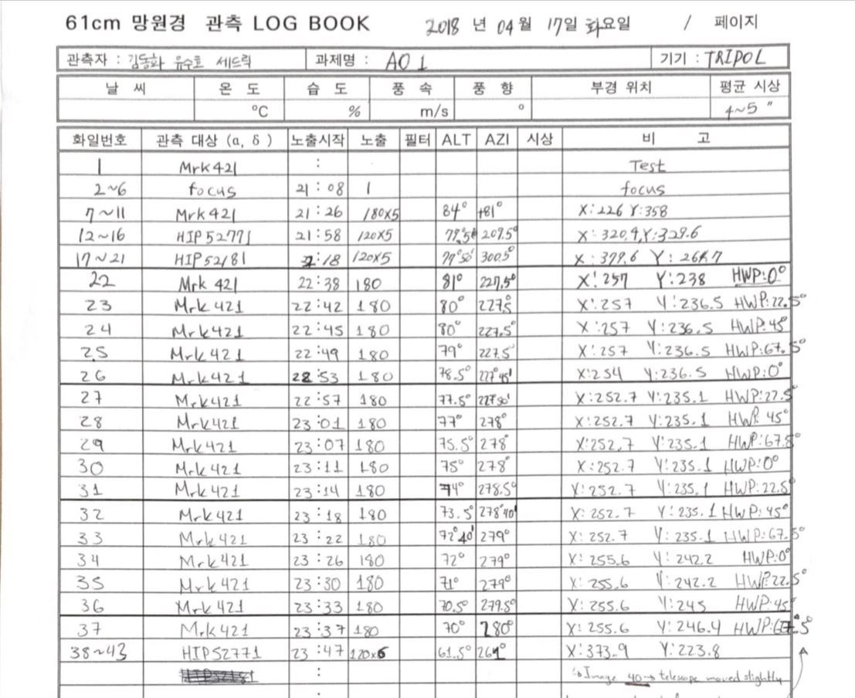
2. Polarimetry
3) Observation schedule
Usual photometry with
variation of polarization degree
( 0° / 22.5° / 45° / 67.5° )
Polarization Degree
Polarized degree

Slide 14
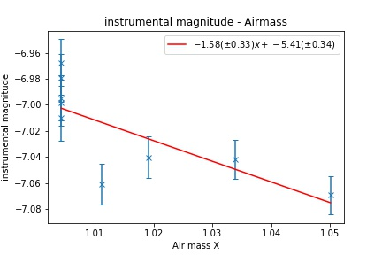
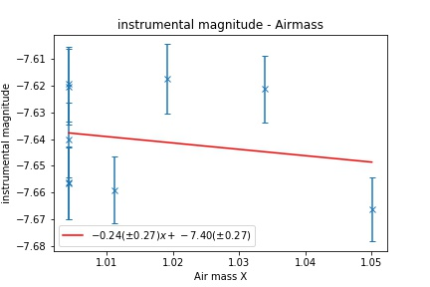
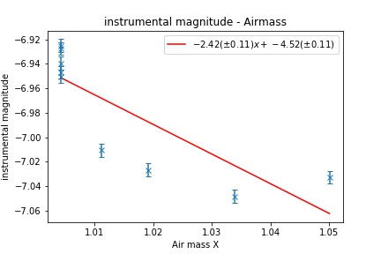
Results
Extinction coefficient (Mrk 421 on April 17th, g’ r’ i’ band in order)
No linear relation found

Slide 15
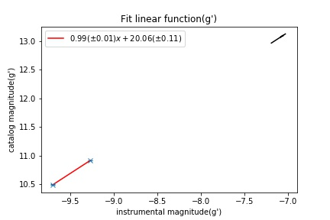
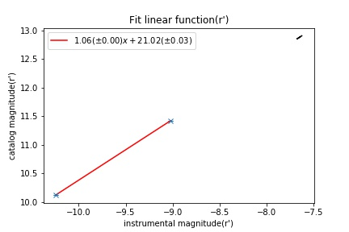
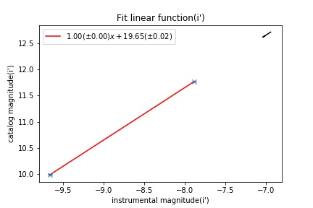
Results
2) Linear fitting (g’ r’ i’ band in order) - April 17th

Slide 16
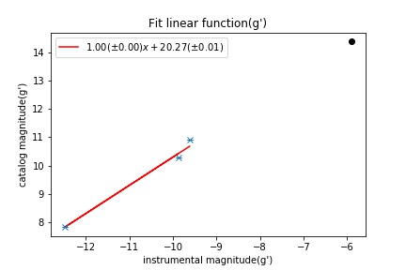
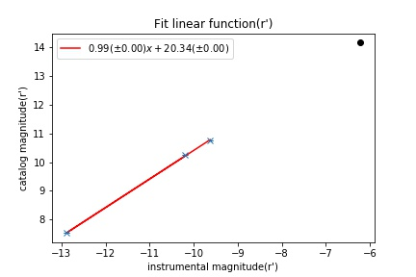
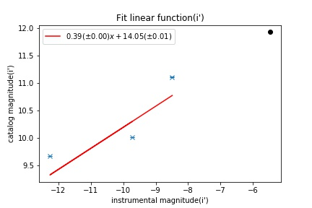
Results
2) Linear fitting (g’ r’ i’ filter in order) - 8th of May (51 UMa included)

Slide 17
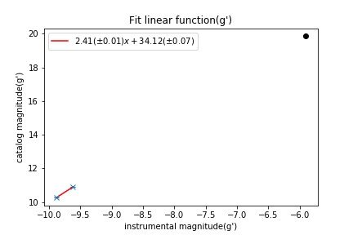
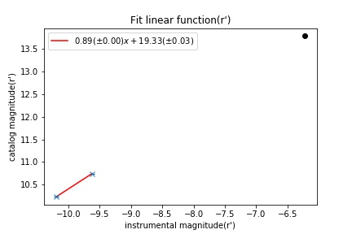
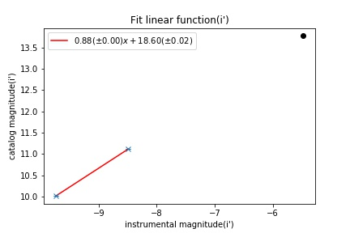
Results
2) Linear fitting (g’ r’ i’ filter in order) - 8th of May (51 UMa not included)
Standard stars nor 51 UMa are reliable

Slide 18
Results
3) Photometry results (magnitudes)
 | g’ | r’ | i’
17th of April | 13.10 | 12.89 | 12.71
8th of May (51 UMA included) | 14.38 | 14.15 | 11.93
8th of May (51 UMA not included) | 19.86 | 13.77 | 13.77
Category | 13.80 | 13.09 | 12.81

Slide 19
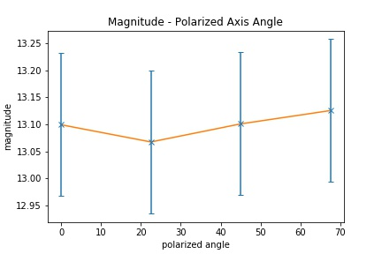
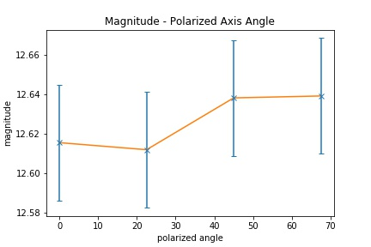
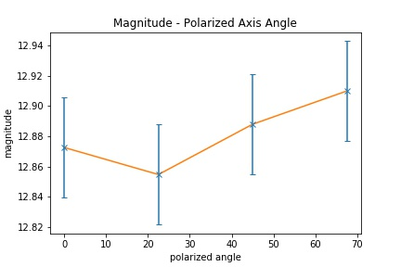
Results
4) Magnitude - polarized axis angle (g’ r’ i’ filter in order)
 | g’ | r’ | i’
P(%) | 2.675 | 2.473 | 1.636
Previous Research (R band) | Primary data source showed an average of 3.62%±0.10% with intranight fluctuations of 1~2% [5]

Slide 20
Conclusion
Failed to measure extinction coefficient
Second day standard stars were not reliable (as data analysis is inconclusive), it is necessary to observe more stars. It might be a result of similar brightness characteristics
51 UMa does not have enough observation data to be used as a standard star and SDSS data mentions that it is highly unreliable. So it is better not use as one and previous researches recommends the same as well.
Polarized observation data is not quite satisfying, probably due to the companion galaxy’s emission, issue that couldn’t be resolved.
First observation night provided acceptable data, measurements show small variations from the category magnitude little difference from the category magnitude is measured. This might be due to polarization issues and variance of AGN luminosity.
More observations in a longer period of time are needed in order to obtain more reliable information on Mrk 421 behaviour. As well as possible jet activity, accretion matter, opening opportunities for other kind of researches.
Corrections to coding are necessary for future observations, leading to better data analysis and, therefore, more reliable results.

Slide 21
Thank you !
감사합니다!
¡Gracias!
ありがとう

Slide 22
References
B. Glenn Piner1, Niraj Pant etal., nov 2010, “THE JETS OF TeV BLAZARS AT HIGHER RESOLUTION: 43 GHz AND POLARIMETRIC VLBAOBSERVATIONS FROM 2005 TO 2009”, The Astrophysical Journal, page 1150-1167
Fraija, N., Benítez, E., Hiriart, D., Sorcia, M., López, J., Mújica, R., Cabrera, J., Diego, J., Rojas-Luis, M., Salazar-Vázquez, F. and Galván-Gámez, A. (2017). Long-term Optical Polarization Variability and Multiwavelength Analysis of Blazar Mrk 421. The Astrophysical Journal Supplement Series, 232(1), p.7.
Gorham, P., van Zee, L., Unwin, S. and Jacobs, C. (2000). Markarian 421’[CSC]s[/CSC] Unusual Satellite Galaxy. The Astronomical Journal, 119(4), pp.1677-1686.
In-the-sky.org, “The star 51-Uma”, 2018-06-13, https://in-thesky.org/data/object.php?id=TYC3010-2500-1#source_01
N. Fraija1, E. Benítez etal., sep 2017, “Long-term Optical Polarization Variability and Multiwavelength Analysis of BlazarMrk 421”, The Astrophysical Journal Supplement Series 232:7, page 25
M. Balokovi ́c, D. Paneque etal. , dec 2015, “Multiwavelength Study of Quiescent States of Mrk 421 with Unprecedented Hard X-Ray Coverage Provided by NuSTAR in 2013”, The Astrophysical Journal
ResearchGate, “How can I measure the linear degree of polarization at 90 degrees?”, 2018-16-13, https://www.researchgate.net/post/How_can_I_measure_the_linear_degree_of_polarization_at_90_degrees2
Simbad, 2018-06-13, http://simbad.u-strasbg.fr/simbad/sim-fbasic
Staralt, 2018-06-13, http://catserver.ing.iac.es/staralt/
Space telescope, “Magnetic funnel around a supermassive black hole“, 2018-06-13, https://www.spacetelescope.org/images/opo1332b/
Tramacere, A., Giommi, P., Perri, M., Verrecchia, F. and Tosti, G. (2009). Swift observations of the very intense flaring activity of Mrk 421 during 2006. I. Phenomenological picture of electron acceleration and predictions for MeV/GeV emission. Astronomy & Astrophysics, 501(3), pp.879-898.
Xu Chen, Shao Ming Hu∗& Di Fu Guo, 2014, "Microvariability Detection of Mrk 421” , J. Astrophys. Astr.
Xu Chen·Shao Ming Hu etal. ,2014, “Optical variability of Mrk 421”, Astrophys Space Sci, page 909-917

